Slide 1
WHAT SHALL BE DONE IF
DONOR FUNDING
TO FIGHT HIV DRASTICALLY
DECREASES
TRANSITION TO SUSTAINABLE FUNDING OF SOCIAL CARE SERVICES FOR PLHIV THROUGH REGIONAL BUDGETS IN UKRAINE
IRYNA KOVALCHUK [UKRAINE]
Notes:
Good afternoon ladies and gentlemen. Thank you for the possibility to make the presentation on such important topic regarding search of alternative sources for financing of social care services. My case describes situation in Ukraine, but I hope that many of you will see possibilities for your communities as well.

Slide 2
BACKGROUND
Notes:
At first. I would like briefly to describe situation with HIV epidemic in Ukraine

Slide 3
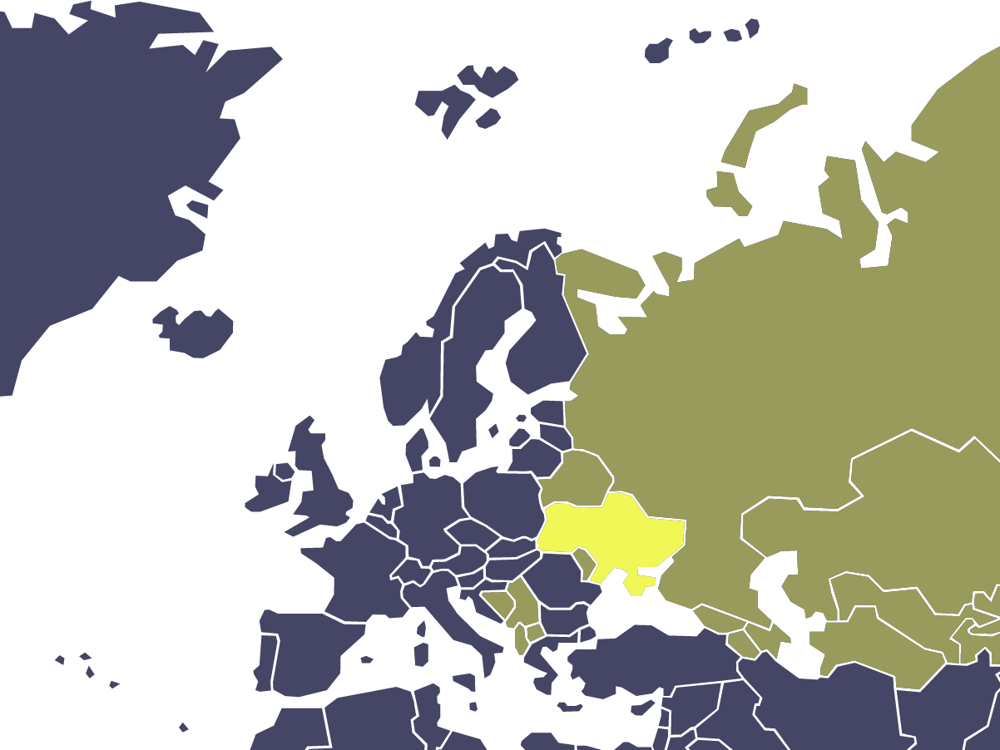
HIV AND AIDS IN UKRAINE
KEY FACTS
Ukraine has the second-largest HIV epidemic in Eastern Europe and Central Asia.
241 000 people living with HIV (est.)
141 317 people living with HIV who know their status
18 194 new HIV infections in 2017
88 270 people receiving ART
90 000 people under social care services
UA
Source: Ukrainian Center for Public Health
Notes:
Ukraine has the second-largest HIV epidemic in Eastern Europe and Central Asia
As you see, there are a lot of people who require social care services. There are many NGOs and programs running nowadays in Ukraine to fight HIV epidemic. But most of them depend on funds from external donors, mostly the Global Fund.

Slide 4
PROBLEM STATEMENT
Notes:
It is more or less easy to run activities, when you have support from international funds and other countries, but it can’t last forever. So, you must change, find new ways to continue financing of activities.

Slide 5
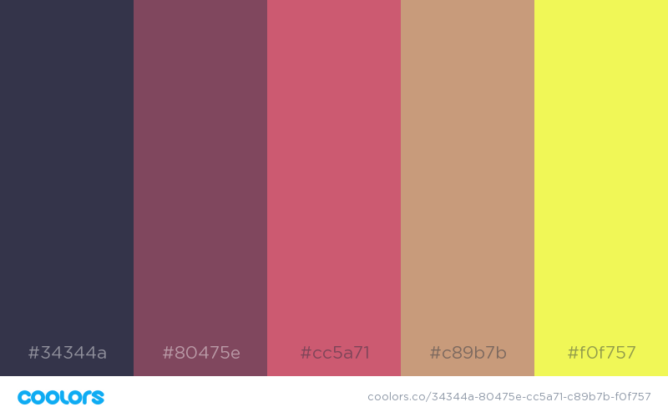
HIV IN UKRAINE
FINANCING
Global Fund to Fight
AIDS (GF) is largest external donor to cover approx. 40% of all funds to fight HIV in 2015-2017 *
41%
32%
GLOBAL FUND
TO BE DEFINED
8%
GLOBAL FUND
59%
60%
OTHERS
OTHERS
Starting from 2018 GF funding drastically decreases to 8% of required funds in 2020**
2017
2020
* National AIDS Spending Assessment (NASA)
**Estimated based on Grant Confirmation made by the “Global Fund” and
All-Ukrainian Network of People Living with HIV/AIDS
Notes:
As you see dependence from the GF funding in Ukraine was pretty high in previous years but starting from 2018 the GF funding is drastically decreasing. Ukrainian government had already supported life-saving care such as healthcare and ART purchasing, but rest of services were funded by external donors. So, we, Ukrainian NGOs, had to find a solution, how to cover the deficit of funds and continue to provide social care services without impact on quantity and quality. Furthermore, it had to be done based on Ukrainian internal funds (national or regional budgets) in conditions of ongoing war with russia.

Slide 6
PROPOSED SOLUTION
Notes:
In 2017 All-Ukrainian Network of PLHIV, the biggest patient NGO in Ukraine, started to look for alternative sources of financing

Slide 7
POTENTIAL SOURCES OF FUNDING
REGIONAL LEVEL
NATIONAL LEVEL
SUCCESSFULLY
IMPLEMENTED
IN PROGRESS
Notes:
2 potential sources have been defined – national and regional state budgets of Ukraine.
We have started pilot projects on regional level, so that regional success stories can be implemented on national level later on.

Slide 8
PORTFOLIO OF INTERVENTIONS
AT REGIONAL LEVEL
PRIMARY
SECONDARY
Development of regional policies on funding of social care services
Obtain funds of regional budgets for social care services provided by NGOs
Develop mechanism for direct purchases of social care services from regional NGOs through the system of electronic public procurement
Advocating for lower rental fee and housing and communal services prices for NGOs to decrease administrative costs of NGOs to lower cost of social care services provided by NGOs
Introduction of social worker position in public health care facilities
Notes:
The Network has designed a set of interventions at regional level with primary and secondary activities. Primary activities were aimed on development of regional policies, then obtaining funds from regional budgets and finally introductions of mechanisms of direct purchases of social care services from NGOs. Same time, secondary activities allowed to decrease cost of such services.

Slide 9
REGIONAL POLICIES
21 from 27 regions adopted local policies on funding of social care services
Regional policies:
In progress
Adopted
To be adopted
Notes:
As a result of interventions 21 regional authorities have already adopted policies regarding financing of social care services and started to allocate funds in regional budgets for direct purchases from NGOs. Rest of regions are in process of adoption or at final negotiations stage.

Slide 10
REGIONAL FUNDING
Regional budget holder purchases social care services for PLHIV and KP from NGOs
ADVANTAGES:
Funding of social care services according to local priorities
Decrease of cost of services by using electronic public procurement
NGOs continue to provide social care services and can improve their portfolio of services according to regional needs
Notes:
Regional funding is beneficiary for all parties since funding is done based on local priorities of communities and NGOs can adjust their services according to those needs. This is a win-win situation.

Slide 11
REGIONAL FUNDING
Regional budget holder purchases social care services for PLHIV and KP from NGOs
ADVANTAGES:
WHO CAN PURCHASE?
Funding of social care services according to local priorities
Decrease of cost of services by using electronic public procurement
NGOs continue to provide social care services and can improve their portfolio of services according to regional needs
Regional health departments.
Regional social care departments.
Regional Healthcare facilities.
Municipal, county, and community healthcare facilities including AIDS centers, TB hospitals, drug rehab centers.
Notes:
Buyers of such services can be a wide variety of regional state health and social care institutions. It is important to mention that those institutions already had experience of cooperation with NGOs and using their services funded by the GF. This means that those institutions have positive experience and are willing to continue receiving services from NGOs even if they must pay themselves.

Slide 12
LVIV REGION FUNDING CASE
2017
2018H1
ADULT PLHIV
400
350
CHILDREN AFFECTED
BY AIDS EPIDEMIC
220
0
CHILDREN PLHIV
0
30
OST PATIENTS
PALLIATIVE PLHIV
0
75
0
100
BUYERS
1
2
TOTAL FUNDS
$19.900
$26.600
Notes:
I would like to show an example of just 1 region with 3000 people living with HIV.
Till 2017 funding was provided only by the GF. Despite this starting from 2017 the Network was able to receive funds from regional budget on social care services. And in first half of 2018 such funding has already exceeded previous year, one more buyer started to purchase servicers and quality of coverage improves as well.

Slide 13
REGIONAL IMPACT
2017
2018H1
$163.000
2 599 PEOPLE
≈
$97.842
$60.251
860 PEOPLE
$97.842
Social care services funded through local budgets
Funds and clients
Additional benefits from local budgets
(Secondary interventions
at regional level)
Notes:
Financial results of advocacy activities show that proactive role of NGOs can ensure sustainability of vital social care services for PLHIV and implement the plan for the transition from donor funding to domestic regional funding.
In 2017, after new regional policies introduction, regions allocated funding in amount of approx. $60 000 in total from regional budgets for purchases of social care services for PLHIV delivered by regional NGOs. Additionally, 860 people got social support.
Furthermore, approx. $ 163.000 are planned in first half 2018 as well and 2599 people will get social care services.
Also, secondary advocacy activities allowed to save almost $100 000 on rental fees and other payments for NGOs annually, as a result less funding will be needed or saved funds can be allocated directly to activities to cover more people or provide additional services.

Slide 14
YOU NEVER CHANGE THINGS BY
FIGHTING AGAINST
THE EXISTING REALITY
TO CHANGE SOMETHING, BUILD
THAT MAKES THE OLD MODEL OBSOLETE
Buckminster Fuller
Notes:
"Bucky" Fuller ounce sad
«You never change things by fighting the existing reality. To change something, build a new model that makes the existing model obsolete»
Interventions made by All-Ukrainian Network of PLHIV allowed creating environment for transition to sustainable funding of social care services for PLHIV through regional budgets.
Also best practices are used by many NGOs in other social care sectors on regional level.

Slide 15
ALL-UKRAINIAN NETWORK
OF PEOPLE LIVING WITH HIV/AIDS
All.Ukrainian.Network.of.PLWH
network_of_plwh

